Slide 1

Golf Player Time Management
Adam Horle, Alyssa Beeker, Bailey Carlin, Daniel Teel, Elijah Hunt
Notes:
25 minutes to present so go slow and explain different functionalities in more detail

Slide 2

Meet the team
Adam Horle - Mobile application development
Alyssa Beeker - Support
Bailey Carlin - Design and support
Daniel Teel - Website development
Elijah Hunt - Mobile application development
Notes:
Presented by Bailey

Slide 3

What is GPTM?
Golf Player Time Management is an application with two components that serve two main functions:
A web application that serves as an Administrator Dashboard that allows course owners to edit the course's information (Geofence the holes and set specific information for each hole), monitor players' behaviour on the course, and receive requests from players.
A mobile Android application that will allow players to play anonymously or play as a registered member. As a registered member players will be able to see their game history as well as see course information and make requests whereas an anonymous user will only have access to course information and have the ability to make requests.
Notes:
Presented by Bailey

Slide 4

Why GPTM?
There’s nothing more frustrating than playing a godly round of golf and having your momentum being thrown off by having to wait to play a hole because a player is taking forever. Our app, Golf Player Time Management, seeks to alleviate this issue. With our app, players will be able to see the wait times for other holes and can be prepared to adjust play relative to other players. Requests can be sent to pass holes and notifications will be delivered to prompt slow players to allow other players to play before them or speed up their own play. Players will also gain the convenience of requesting concessions and/or services from anywhere on the course.
Notes:
Presented by Bailey

Slide 5
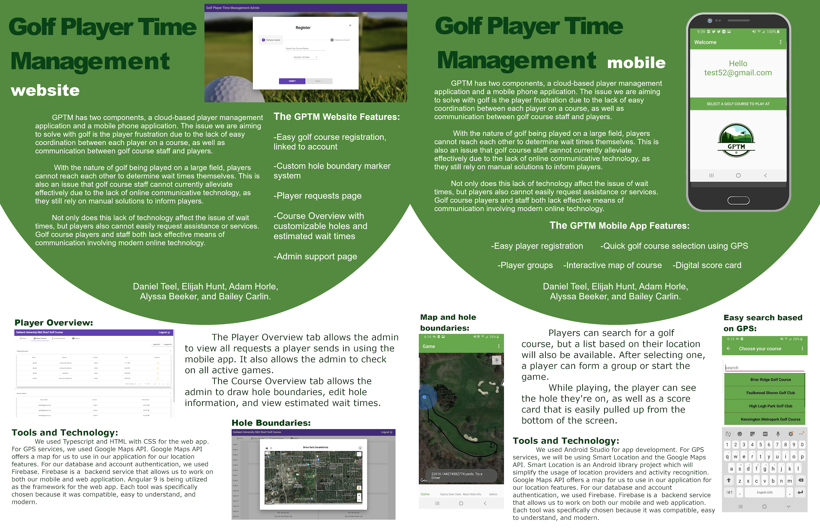
Notes:
Presented by Bailey

Slide 6
Technologies and System Requirements

Slide 7

Technologies
Web Application
Angular v9 for the framework
TypeScript v3.7.5
Graph.js for the charts
Google Maps for the geofencing and location services
Mobile Application
Android SDK v28
Google Maps for location services
Shared
Firebase
Real Time Database
User Authentication
Functions
Notes:
Presented by Alyssa

Slide 8

Risks
Potential Database Issues
Risk mitigation strategy
Limit the structure to a set template for every course with no deviation other than 9 or 18 holes
Clear old data (unless it’s player history) from the database each night
Mobile/Web App Communication Issues
Risk mitigation strategy
Utilize services that are known to be reliable and have minimal downtime
Location Service Issues
Risk mitigation strategy
Save coordinates in Firebase in case a refresh is needed
Notes:
Presented by Alyssa

Slide 9

System Requirements
Admin Website
Any device that has a modern internet browser installed
A larger screened device is preferable since there is potential to be quite a lot of data
Flex property allows scaling, however, a prompt will appear to ask users to tilt devices into landscape to preserve the scale and readability of charts and graphs
Mobile Application
Any device running Android 4.0.3 Ice Cream Sandwich or higher with Google Play Store connectivity
GPS turned on
Mobile data turned on
Notes:
Presented by Alyssa

Slide 10
Development and Demo

Slide 11

Admin Website Development
Sprint 1
Functional requirements, UI wireframe designs
NOTE: Admin Website was not added to development plan until after the Sprint 1 Demo
Sprint 2
User authentication
Login, register, password change, email verification, email change
Layout/navigation
Sprint 3
Course Overview Page
Data view and edit for each hole
Sprint 4
Course geofencing shared component
Course Overview page redesign
Redesign from a series to accordions to a nav list with 5 tiles per list item in the nav content
Sprint 5
Player Overview Page
Pull in data for users on the course and display in a table
Sprint 6
Course wait times/congestion calculations and graphs
Support Page
Notes:
Presented by Danny

Slide 12
Admin Website Demo
https://golf-player-time-management.firebaseapp.com
Notes:
Presented by Danny
Flow of registering a new course and editing one hole
Flow of managing a course with an already completed account

Slide 13

Mobile Application Development
Sprint 1
Functional requirements, UI wireframe designs
Sprint 2
User authentication
Login, register, password change, email verification, email change
Layout/navigation
Firebase functionality added
Sprint 3
Set groundwork for Google Maps API
Create template for the game screen
Simple group functionality added
Automatic login created
Initial anonymous signin created
Sprint 4
Able to select golf course through list
Requests added
Google Maps worked on
Sprint 5
Game screen is finalized
Group selection is finalized
Google Maps finalized
Assistance and timer added
Sprint 6
Finalize UI
Code cleanup
Anonymous redone
Notes:
Presented by Eli and Adam

Slide 14
Mobile Application Demo
https://www.youtube.com/watch?v=3ZTA5kJUoUc
https://www.youtube.com/watch?v=7PJljBY1pYI&feature=youtu.be
Notes:
Presented by Eli and Adam

Slide 15
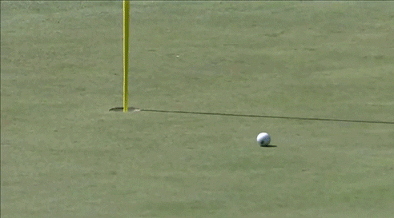
Questions?

